Slide 1
Foundations of Cryptography equivalence between IND-EAV definitions, statistical distance
LiangFeng Zhang
zhanglf@shanghaitech.edu.cn

Slide 2
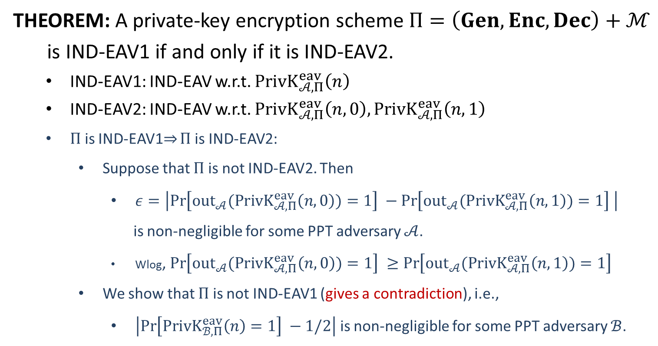
Equivalence
THEOREM: A private-key encryption scheme $Π=\left(Gen, Enc, Dec\right)+ℳ$
is IND-EAV1 if and only if it is IND-EAV2.
IND-EAV1: IND-EAV w.r.t. $PrivK_{𝒜, Π}^{eav}\left(n\right)$
IND-EAV2: IND-EAV w.r.t. $PrivK_{𝒜, Π}^{eav}\left(n,0\right),PrivK_{𝒜, Π}^{eav}\left(n,1\right)$
$Π$ is IND-EAV1$⇒$ $Π$ is IND-EAV2:
Suppose that $Π$ is not IND-EAV2. Then
$ε=\left|\operatorname{Pr}\left[{out}_{𝒜}(PrivK_{𝒜, Π}^{eav}\left(n,0\right))=1\right] −\operatorname{Pr}\left[{out}_{𝒜}(PrivK_{𝒜, Π}^{eav}\left(n,1\right))=1\right] \right|$
is non-negligible for some PPT adversary $𝒜$.
Wlog, $\operatorname{Pr}\left[{out}_{𝒜}(PrivK_{𝒜, Π}^{eav}\left(n,0\right))=1\right] ≥\operatorname{Pr}\left[{out}_{𝒜}(PrivK_{𝒜, Π}^{eav}\left(n,1\right))=1\right]$
We show that $Π$ is not IND-EAV1 (gives a contradiction), i.e.,
$\left|\operatorname{Pr}\left[PrivK_{ℬ, Π}^{eav}\left(n\right)=1\right] −1/2\right|$ is non-negligible for some PPT adversary $ℬ$.

Slide 3












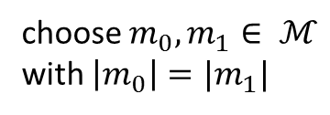


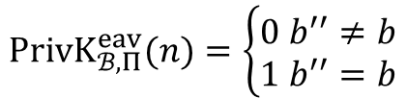

choose $m_{0}, m_{1}∈ ℳ$
with $\left|m_{0}\right|=|m_{1}|$
$$m_{0},m_{1}$$
$$m_{0},m_{1}$$
$$k←Gen\left(1^{n}\right)$$
$$b←\{0,1\}$$
$$c←Enc(k,m_{b})$$
$$c$$
$$c$$
$$b′$$
$$b^{′′}=\left\{\begin{aligned}0 b^{′}=1 \\ 1 b^{′}=0\end{aligned}\right.$$
$$b′′$$
$$PrivK_{ℬ, Π}^{eav}(n)=\left\{\begin{aligned}0 b^{′′}≠b \\ 1 b^{′′}=b\end{aligned}\right.$$
$$Challenger$$
$$𝓑$$
$$𝓐$$
$$PrivK_{𝓑 , Π}^{eav}\left(n\right)$$
$$PrivK_{𝒜, Π}^{eav}\left(n,b\right)$$

Slide 4
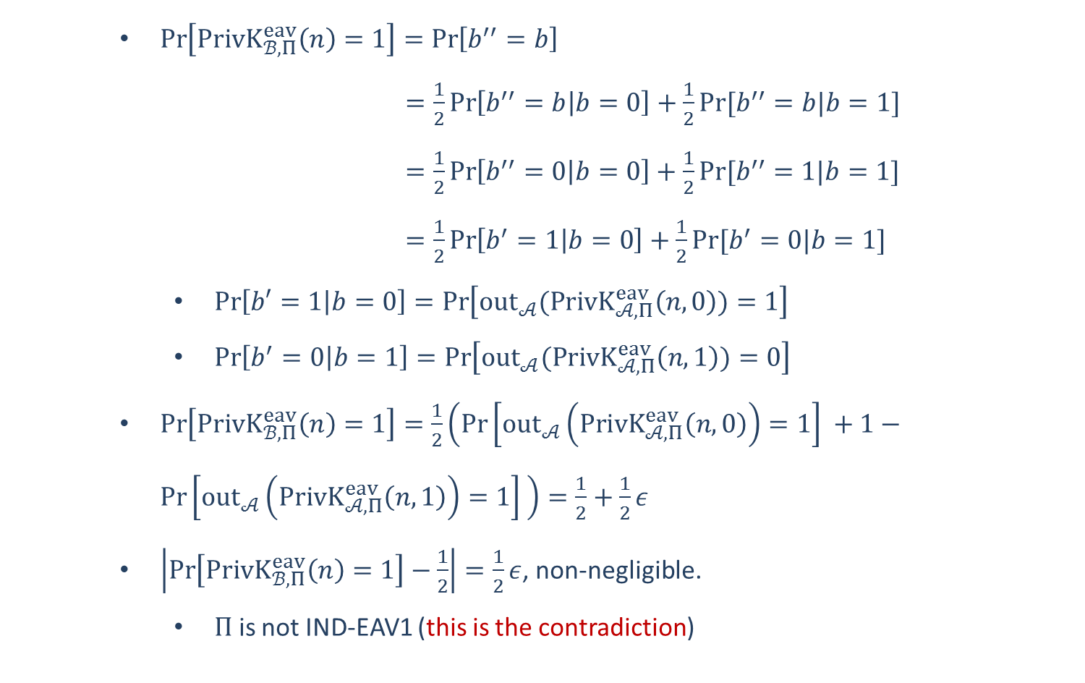
$\operatorname{Pr}\left[PrivK_{ℬ, Π}^{eav}\left(n\right)=1\right]=\operatorname{Pr}\left[b^{′′}=b\right]$
$=\frac{1}{2}\operatorname{Pr}\left[b^{′′}=b | b=0\right]+\frac{1}{2}Pr⁡[b^{′′}=b|b=1]$
$=\frac{1}{2}\operatorname{Pr}\left[b^{′′}=0 | b=0\right]+\frac{1}{2}Pr⁡[b^{′′}=1|b=1]$
$=\frac{1}{2}\operatorname{Pr}\left[b^{′}=1 | b=0\right]+\frac{1}{2}Pr⁡[b^{′}=0|b=1]$
$\operatorname{Pr}\left[b′=1 | b=0\right]=\operatorname{Pr}\left[{out}_{𝒜}(PrivK_{𝒜, Π}^{eav}\left(n,0\right))=1\right]$
$\operatorname{Pr}\left[b^{′}=0 | b=1\right]=\operatorname{Pr}\left[{out}_{𝒜}(PrivK_{𝒜, Π}^{eav}\left(n,1\right))=0\right]$
$\operatorname{Pr}\left[PrivK_{ℬ, Π}^{eav}\left(n\right)=1\right]=\frac{1}{2}\left(\operatorname{Pr}\left[{out}_{𝒜}\left(PrivK_{𝒜, Π}^{eav}\left(n,0\right)\right)=1\right] +1−\operatorname{Pr}\left[{out}_{𝒜}\left(PrivK_{𝒜, Π}^{eav}\left(n,1\right)\right)=1\right] \right)=\frac{1}{2}+\frac{1}{2}ε$
$\left|\operatorname{Pr}\left[PrivK_{ℬ, Π}^{eav}\left(n\right)=1\right]−\frac{1}{2}\right|=\frac{1}{2}ε$, non-negligible.
$Π$ is not IND-EAV1 (this is the contradiction)

Slide 5
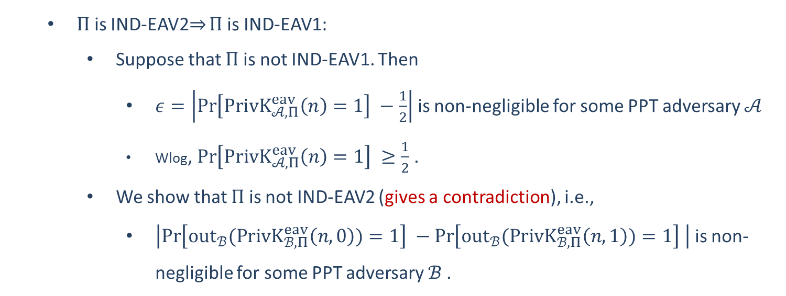
$Π$ is IND-EAV2$⇒$ $Π$ is IND-EAV1:
Suppose that $Π$ is not IND-EAV1. Then
$ε=\left|\operatorname{Pr}\left[PrivK_{𝒜, Π}^{eav}\left(n\right)=1\right] −\frac{1}{2}\right|$ is non-negligible for some PPT adversary $𝒜$
Wlog, $\operatorname{Pr}\left[PrivK_{𝒜, Π}^{eav}\left(n\right)=1\right] ≥\frac{1}{2}$ .
We show that $Π$ is not IND-EAV2 (gives a contradiction), i.e.,
$\left|\operatorname{Pr}\left[{out}_{ℬ}(PrivK_{ℬ, Π}^{eav}\left(n,0\right))=1\right] −\operatorname{Pr}\left[{out}_{ℬ}(PrivK_{ℬ, Π}^{eav}\left(n,1\right))=1\right] \right|$ is non-negligible for some PPT adversary $ℬ$.

Slide 6
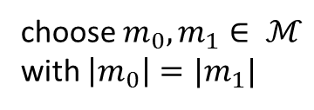













choose $m_{0}, m_{1}∈ ℳ$
with $\left|m_{0}\right|=|m_{1}|$
$$m_{0},m_{1}$$
$$m_{0},m_{1}$$
$$k←Gen\left(1^{n}\right)$$
$$c←Enc(k,m_{b})$$
$$c$$
$$c$$
$$b′$$
$$b′$$
$$Challenger$$
$$𝓑$$
$$𝓐$$
$$PrivK_{𝓑 , Π}^{eav}\left(n,b\right)$$
$$PrivK_{𝒜, Π}^{eav}\left(n\right)$$

Slide 7
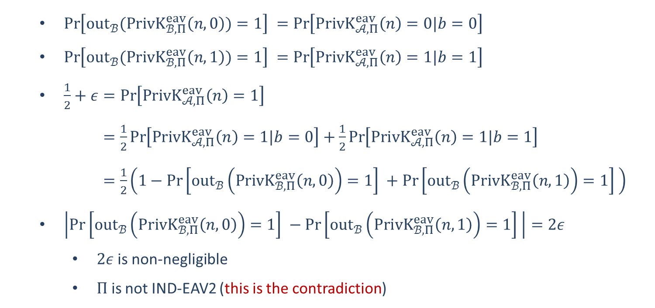
$\operatorname{Pr}\left[{out}_{ℬ}(PrivK_{ℬ, Π}^{eav}\left(n,0\right))=1\right] =\operatorname{Pr}\left[PrivK_{𝒜, Π}^{eav}\left(n\right)=0|b=0\right]$
$\operatorname{Pr}\left[{out}_{ℬ}(PrivK_{ℬ, Π}^{eav}\left(n,1\right))=1\right] =\operatorname{Pr}\left[PrivK_{𝒜, Π}^{eav}\left(n\right)=1|b=1\right]$
$\frac{1}{2}+ε=\operatorname{Pr}\left[PrivK_{𝒜, Π}^{eav}\left(n\right)=1\right]$
$=\frac{1}{2}\operatorname{Pr}\left[PrivK_{𝒜, Π}^{eav}\left(n\right)=1|b=0\right]+\frac{1}{2}\operatorname{Pr}\left[PrivK_{𝒜, Π}^{eav}\left(n\right)=1|b=1\right]$
$=\frac{1}{2}\left(1−\operatorname{Pr}\left[{out}_{ℬ}\left(PrivK_{ℬ, Π}^{eav}\left(n,0\right)\right)=1\right] +\operatorname{Pr}\left[{out}_{ℬ}\left(PrivK_{ℬ, Π}^{eav}\left(n,1\right)\right)=1\right] \right)$
$\left|\operatorname{Pr}\left[{out}_{ℬ}\left(PrivK_{ℬ, Π}^{eav}\left(n,0\right)\right)=1\right] −\operatorname{Pr}\left[{out}_{ℬ}\left(PrivK_{ℬ, Π}^{eav}\left(n,1\right)\right)=1\right] \right|=2ε$
$2ε$is non-negligible
$Π$ is not IND-EAV2 (this is the contradiction)

Slide 8

















OTP is IND-EAV
$$m_{0},m_{1}$$
choose $m_{0}, m_{1}∈{\left\{0,1\right\}}^{n}$
$$k←{\left\{0,1\right\}}^{n}$$
$$c←k⊕m_{0}$$
$$Adversary 𝒜$$
$$Challenger$$
$$c$$
$$b^{′}$$
$$m_{0},m_{1}$$
choose $m_{0}, m_{1}∈{\left\{0,1\right\}}^{n}$
$$k←{\left\{0,1\right\}}^{n}$$
$$Challenger$$
$$c←k⊕m_{1}$$
$$Adversary 𝒜$$
$$c$$
$$b^{′}$$
$$k⊕m_{0}≡k⊕m_{1}$$
$$\operatorname{Pr}\left[{out}_{𝒜}(PrivK_{𝒜, OTP}^{eav}\left(n,0\right))=1\right] =\operatorname{Pr}\left[{out}_{𝒜}(PrivK_{𝒜, OTP}^{eav}\left(n,1\right))=1\right]$$

Slide 9
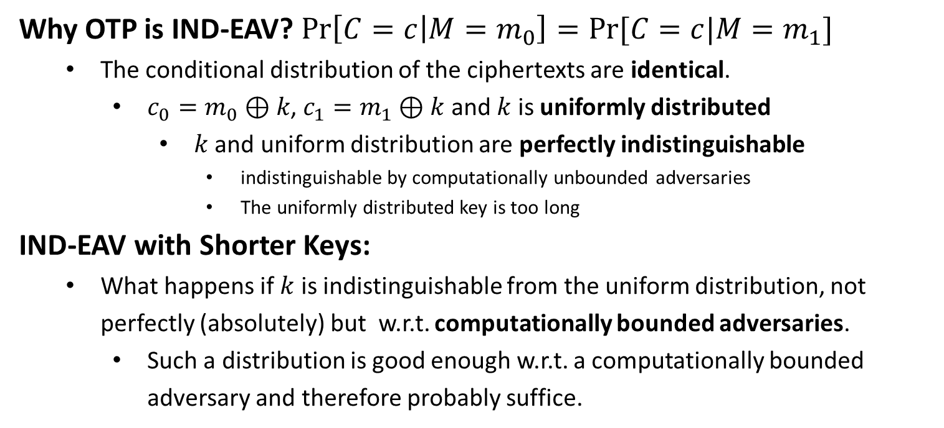
OTP is IND-EAV
Why OTP is IND-EAV? $\operatorname{Pr}\left[C=c | M=m_{0}\right]=Pr⁡[C=c|M=m_{1}]$
The conditional distribution of the ciphertexts are identical.
$c_{0}=m_{0}⊕k$, $c_{1}=m_{1}⊕k$ and $k$ is uniformly distributed
$k$ and uniform distribution are perfectly indistinguishable
indistinguishable by computationally unbounded adversaries
The uniformly distributed key is too long
IND-EAV with Shorter Keys:
What happens if $k$ is indistinguishable from the uniform distribution, not perfectly (absolutely) but w.r.t. computationally bounded adversaries.
Such a distribution is good enough w.r.t. a computationally bounded adversary and therefore probably suffice.

Slide 11
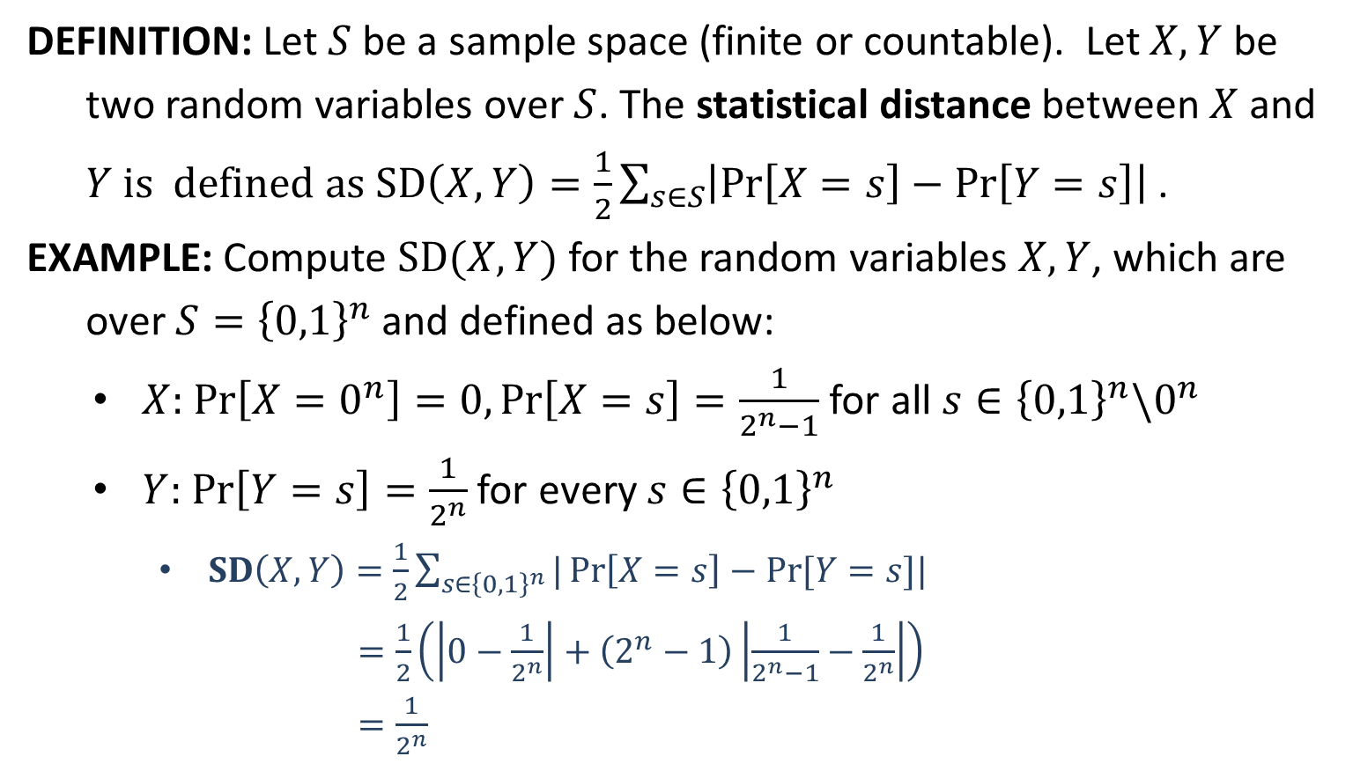
Statistical Distance
DEFINITION: Let $S$ be a sample space (finite or countable). Let $X,Y$ be
two random variables over $S$. The statistical distance between $X$ and
$Y$ is defined as $SD\left(X,Y\right)=\frac{1}{2}\sum_{s∈S}{\left|\operatorname{Pr}\left[X=s\right]−\operatorname{Pr}\left[Y=s\right]\right| }$.
EXAMPLE: Compute $SD(X,Y)$ for the random variables $X,Y$, which are
over $S={\left\{0,1\right\}}^{n}$ and defined as below:
$X:$ $\operatorname{Pr}\left[X=0^{n}\right]=0,\operatorname{Pr}\left[X=s\right]=\frac{1}{2^{n}−1}$ for all $s∈{\left\{0,1\right\}}^{n}\backslash 0^{n}$
$Y:$ $\operatorname{Pr}\left[Y=s\right]=\frac{1}{2^{n}}$ for every $s∈{\left\{0,1\right\}}^{n}$
$SD\left(X,Y\right)=\frac{1}{2}\sum_{s∈{\left\{0,1\right\}}^{n}}{|\operatorname{Pr}\left[X=s\right]−Pr⁡[Y=s]|}$
$=\frac{1}{2}\left(\left|0−\frac{1}{2^{n}}\right|+\left(2^{n}−1\right)\left|\frac{1}{2^{n}−1}−\frac{1}{2^{n}}\right|\right)$
$=\frac{1}{2^{n}}$

